Slide 1
Disaster recovery with ibm cloud virtual servers
Presented by,
R.Divya
e.Janani
r.r.Kanishka
p.kavisri
p.vinothini

Slide 2
Pandemic disaster
Pandemic is a disease outbreak that spreads across countries or continents.
It affects more people and takes more lives than an epidemic.
The world health organization (WHO) declared covid-19 to be a pandemic when it became clear that the illness was severe and that it was spreading quickly over a wide area.

Slide 3
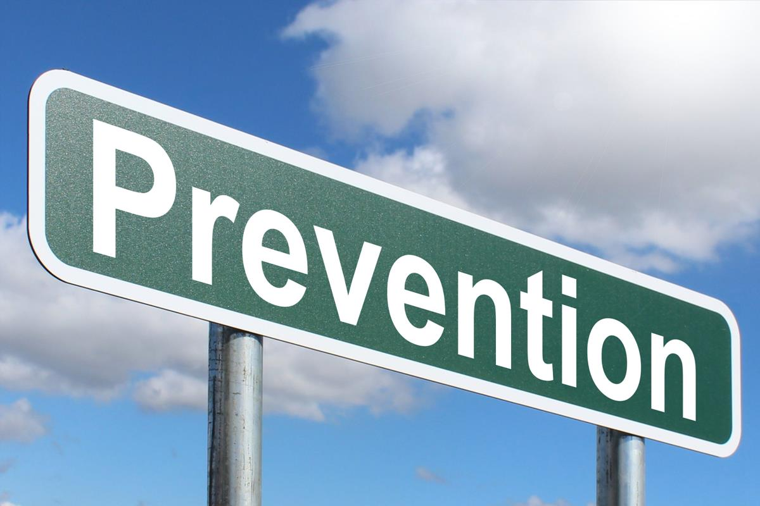
prevention
Wash your hands often with soap and water.
Use an alcohol-based hand cleaner or gel sanitizer
Don't touch your mouth, nose, and eyes unless you've just washed your hands
Avoid crowded places
Stay home if you can.
Clean and disinfect household surfaces every day.

Slide 4
prevention
If you get sick:
Stay home and away from other people
If you want to talk to your doctor, call before you go to their office
Wash your hands often, and keep household surfaces clean and disinfected

Slide 5
preparation
A pandemic causes economic and social problems because so many people are ill or can’t work .
Make an emergency contact list.
Find local aid organizations in case you need information, support, or health services.
Find out whether you can work from home.
Plan home learning activities in case school is closed.

Slide 6

preparation
Store extra water, food, medicine, and supplies.
Stay as healthy as you can by getting rest, managing stress, eating right, and exercising.
Help seniors and neighbors by sharing information and resources.

Slide 7
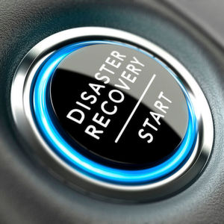
recovery
Eight steps to help with safe home-based recovery
1.Isolate the person with covid-19 and maintain distance
2.Open windows to bring in fresh air
3.Designate care givers
4.Wear masks and maintain hygiene

Slide 8
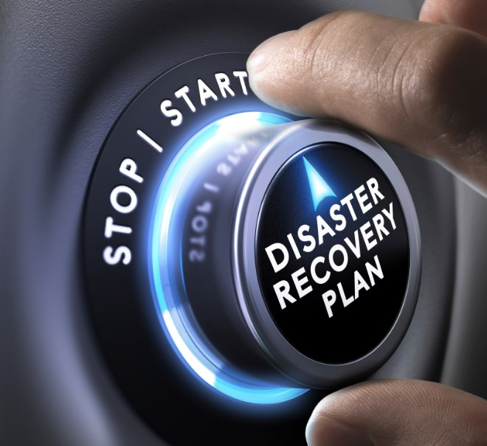
Recovery
5.Treat any symptoms
6.Support mental health
7.No visitors
8.Know the red flags and seek help early

Slide 9


